Slide 1
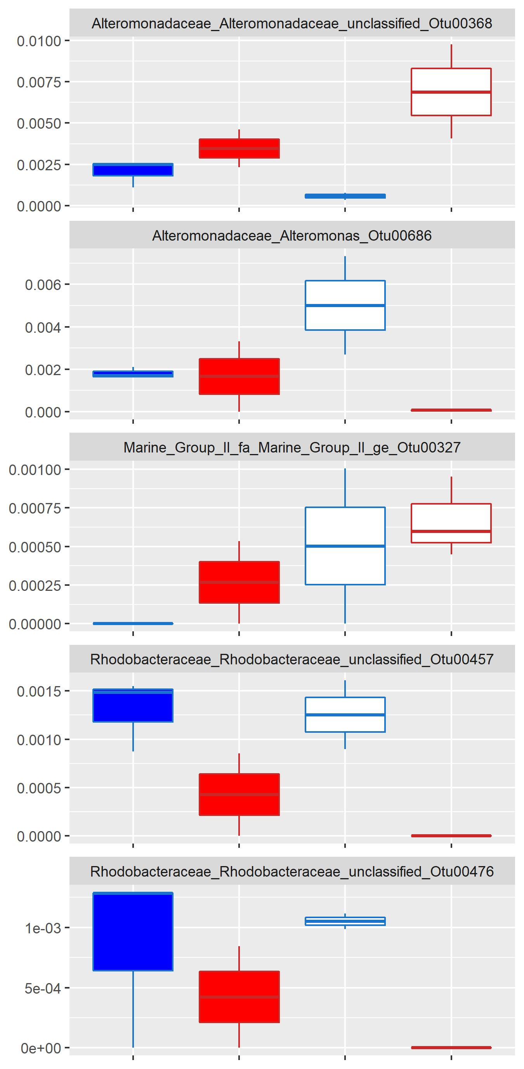
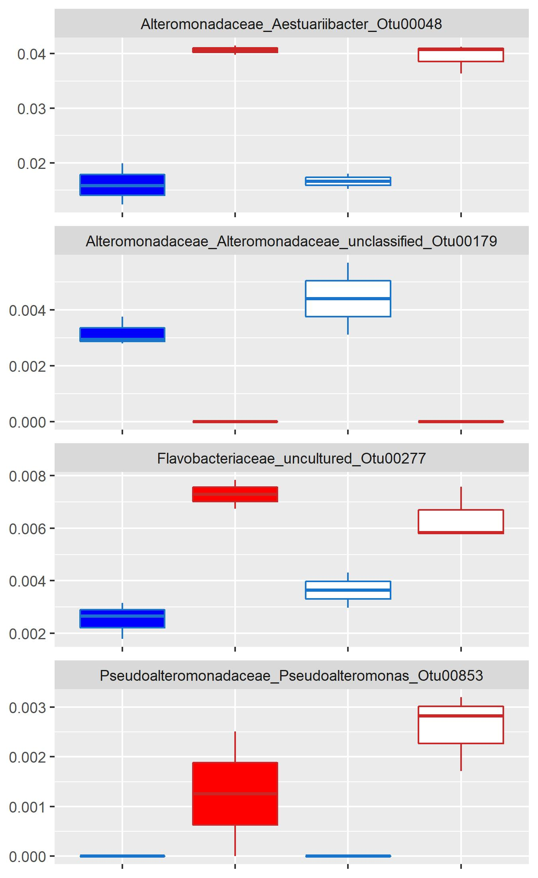
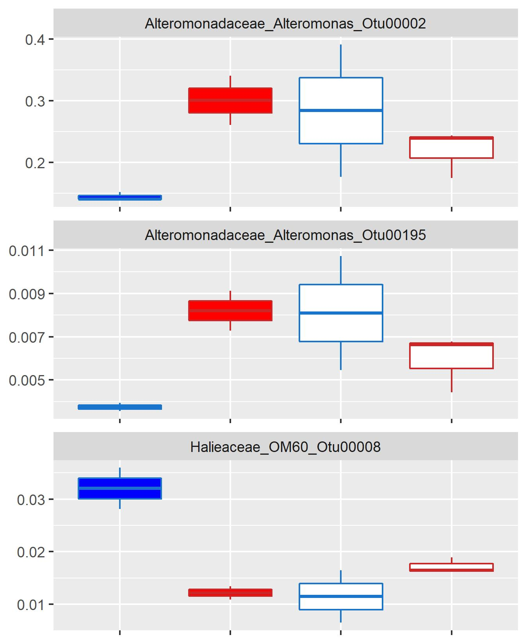
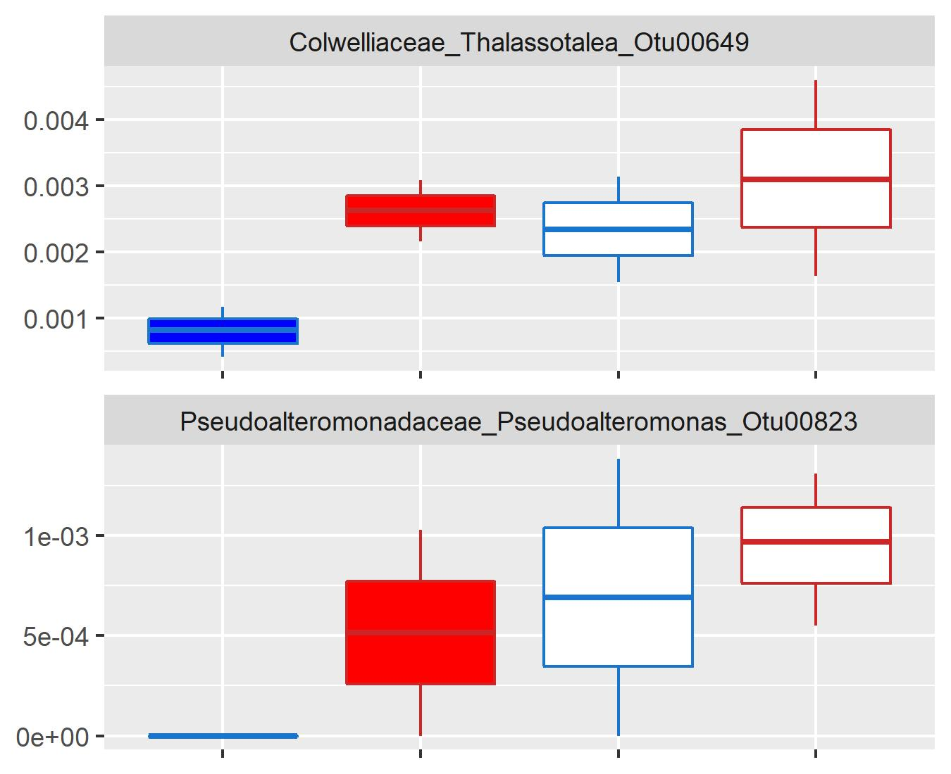
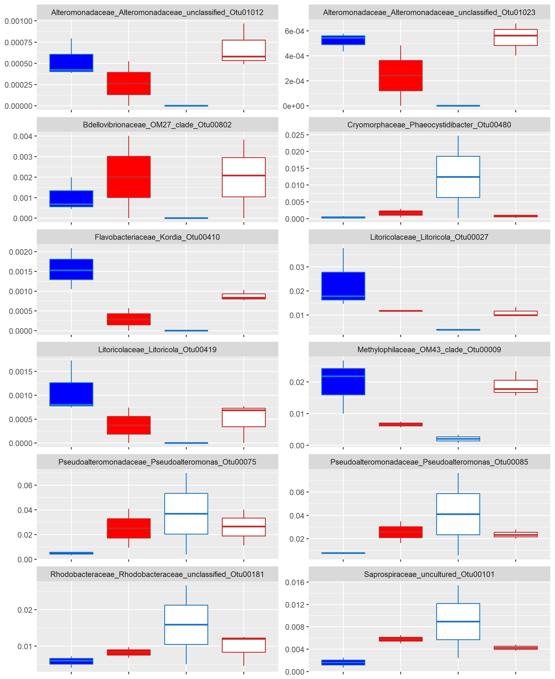
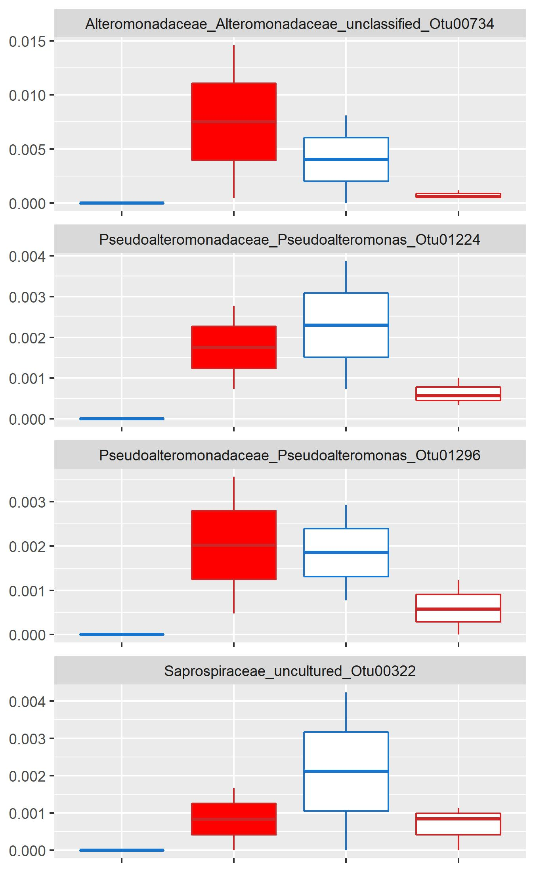
ASVs Enriched In:
Bleached + Ambient
Heated
All treatments
Relative Abundance
Relative Abundance
Relative Abundance

Slide 2
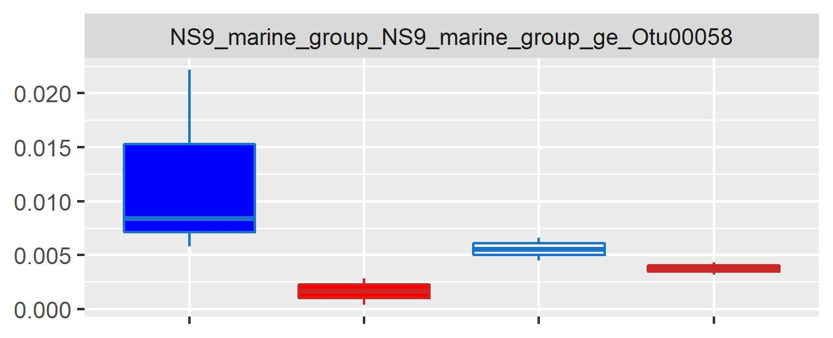
ASVs Depleted In:
Bleached + Ambient
Heated
All treatments
Relative Abundance
Relative Abundance
Relative Abundance

Slide 3
ASVs Enriched In:
Bleached + Ambient
Heated
All treatments
Relative Abundance
Relative Abundance
Relative Abundance
ASVs Depleted In:
Bleached + Ambient
Heated
All treatments
Relative Abundance
Relative Abundance
Relative Abundance

